Slide 1

4RTNI-2 Biorepository Training
Version 10.2018

Slide 2
Training Overview:
4RTNI-2
Study Overview
Kit Review
Specimen Labels
Sample Forms
Sample Collection and Processing
Sample Shipping
NCRAD Website
Common Nonconformance Issues
Questions?

Slide 3
4RTNI-2 Specimen Schedule
 | Cycle 1, Baseline | Cycle 2, Visit 2 | Cycle 3, Visit 3 | Cycle 4, Visit 4
Time (months after baseline) | 0 | 6 | 12 | 24
DNA (Buffy Coat) | X | X | X | X
Plasma | X | X | X | X
PBMC | X
Serum | X
RNA | X
CSF | X | X* | X | X
*Collected at visit 2 only if it is a termination visit

Slide 4
Kit Request Module
4RTNI-2 Kit Request Module

Slide 5
When to Order Kits
Each site will be responsible for ordering kits (labels included) and maintaining a supply on site for scheduled participants
Allow a minimum of 2 weeks for your order to be processed and delivered.

Slide 6
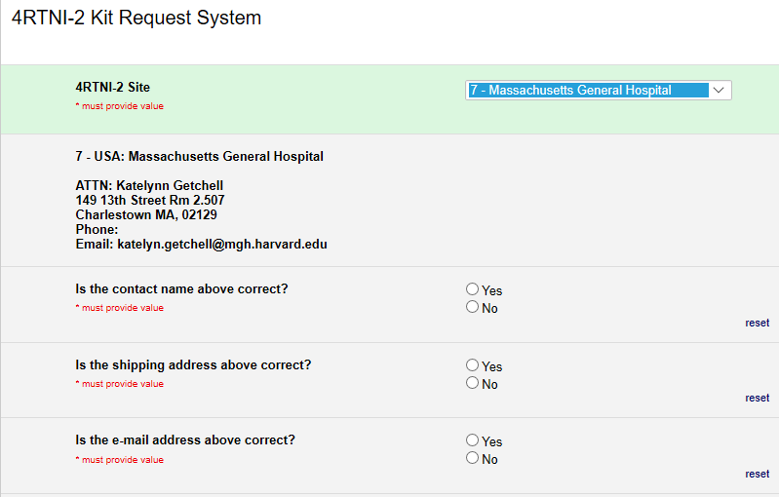
Kit Request Module
Choose your site from the drop-down list.
The coordinator name and contact information will appear.
Verify that this information is accurate, or correct it if necessary.

Slide 7
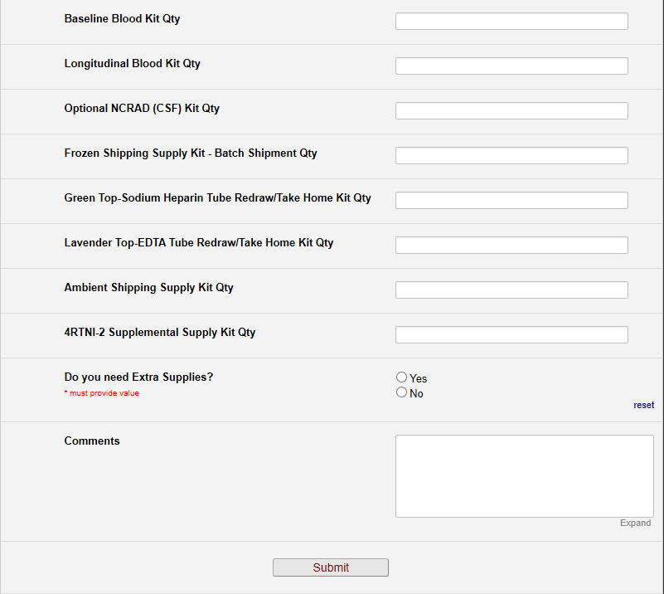
Kit Request Module

Slide 8
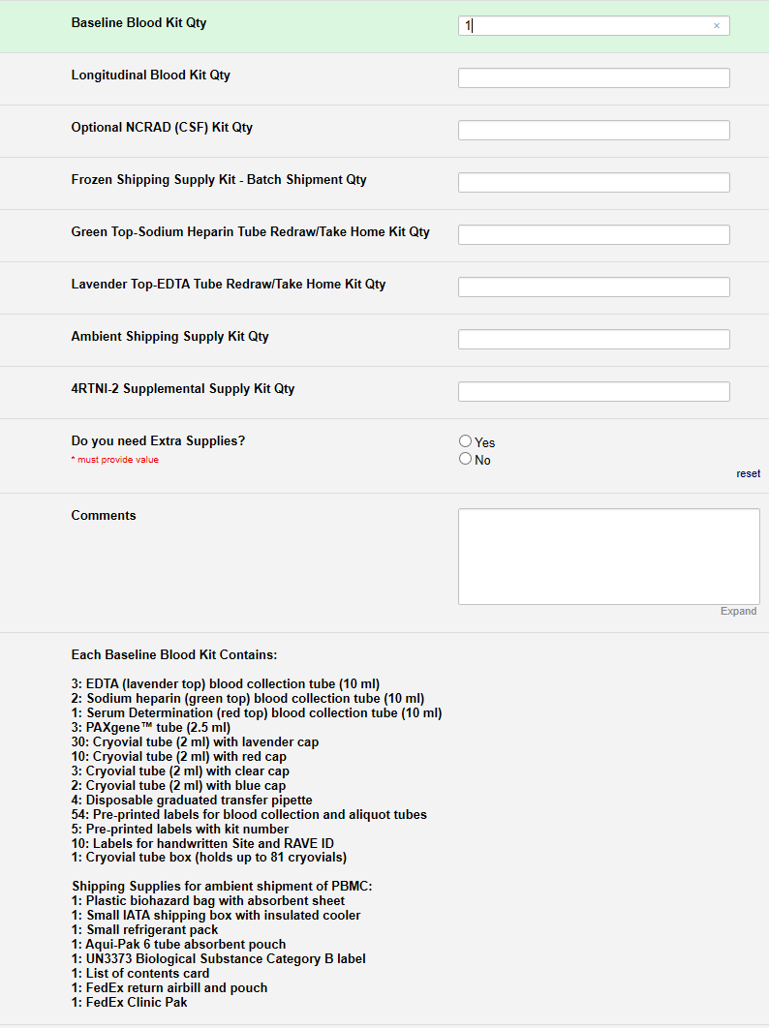
Kit Request Module
Indicate the quantity needed of each kit
Once selected, kit components of the chosen kit will appear at the bottom of the screen (Pictured)
Click “Submit” to turn in your request.
The IU staff will notify you that your request has been received and address any issues.
**Note: You can order more than one type of kit in a single kit request**

Slide 9
4RTNI-2 Baseline Kits
Quantity | 4RTNI-2 Cycle 1, Baseline Blood Kit Components
3 | EDTA (Lavender-Top) Blood Collection Tube (10 ml)
2 | Sodium Heparin (Green-Top) Blood Collection Tube (10 ml)
1 | Serum Determination (Red-Top) Blood Collection Tube (10 ml)
3 | PAXgene™ Blood Collection Tube (2.5 ml)
30 | Cryovial tube (2 ml) with lavender cap
10 | Cryovial tube (2 ml) with red cap
3 | Cryovial tube (2 ml) with clear cap
2 | Cryovial tube (2 ml) with blue cap
4 | Disposable graduated transfer pipette
54 | Pre-printed labels for blood collection and aliquot tubes
5 | Pre-printed labels with kit number
10 | Labels for handwritten Site and RAVE ID
1 | Cryovial tube box (holds up to 81 cryovials)
1 | Shipping Supplies for ambient shipment of PBMC: Plastic biohazard bag w/ absorbent sheet Small IATA shipping box Small refrigerant pack Aqui-Pak 6 tube absorbent pouch UN3373 Biological Substance Category B label List of contents Fed Ex Clinic Pak FedEx return airbill and pouch
Please note:
Sodium Heparin, Serum Determination, and PAXgene™ tubes are only drawn at baseline visit.
3 EDTA tubes at baseline

Slide 10
4RTNI-2 Longitudinal Kits
Quantity | 4RTNI-2 Longitudinal Blood Kit Components
2 | EDTA (Lavender-Top) Blood Collection Tube (10 ml)
20 | Cryovial tube (2 ml) with lavender cap
2 | Cryovial tube (2 ml) with clear cap
1 | Cryovial tube (2 ml) with blue cap
2 | Disposable graduated transfer pipette
27 | Pre-printed labels for blood collection and aliquot tubes
2 | Pre-printed labels with kit number
3 | Labels for handwritten Site and RAVE ID
1 | Cryovial tube box (holds up to 81 cryovials)
Please note:
2 EDTA tubes at longitudinal visit

Slide 11
Redraw/Take Home Kits
Redraw may include:
  EDTA tube, or
  2 x Sodium Heparin tubes
Sample redraw may occur in one of two ways:
  Subject travels to site
  Site staff sends participant kit
    Drawn with local physician
    Cost of draw should be covered by the 4RTNI-2 site by direct payment to physician OR reimbursement to participant

Slide 12
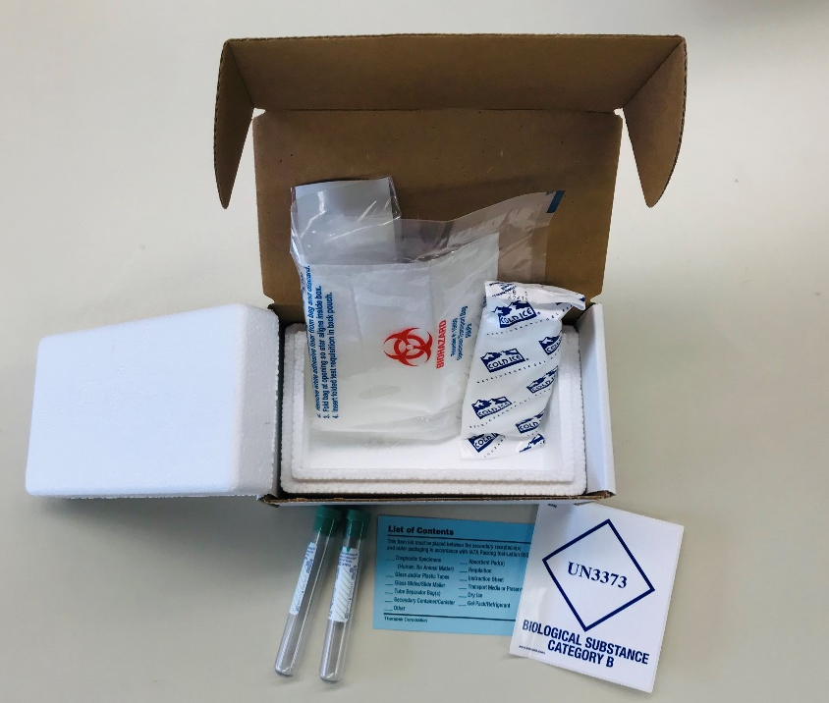
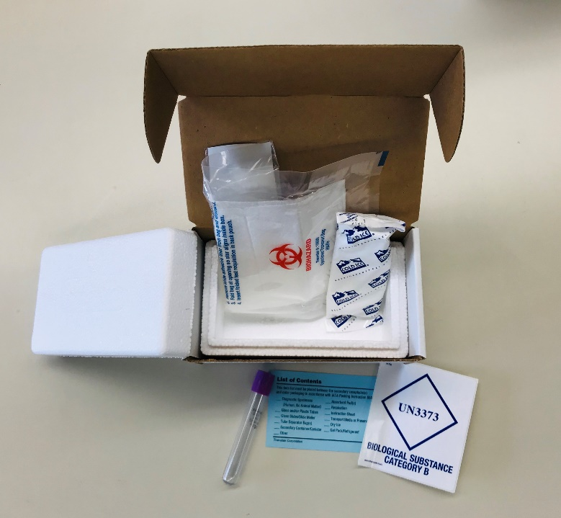
Redraw/Take Home Kit
DNA Redraw/Take Home Kit
  1 EDTA tube
PBMC Redraw/Take Home Kit
  2 PBMC tubes

Slide 13

Specimen Labels

Slide 14

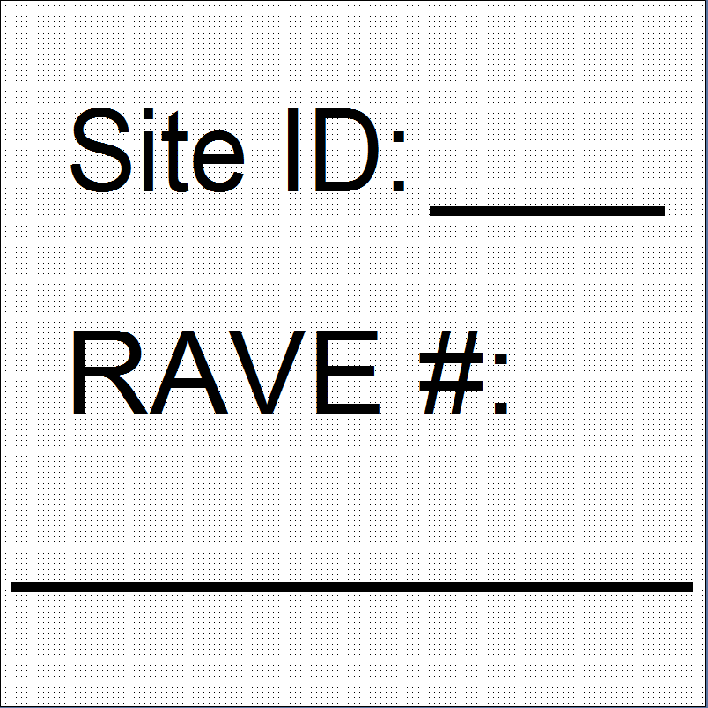
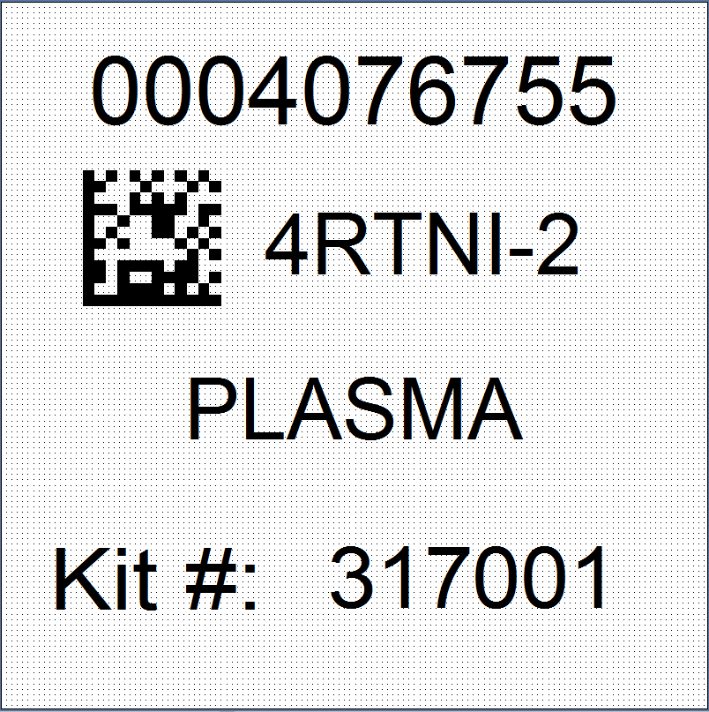
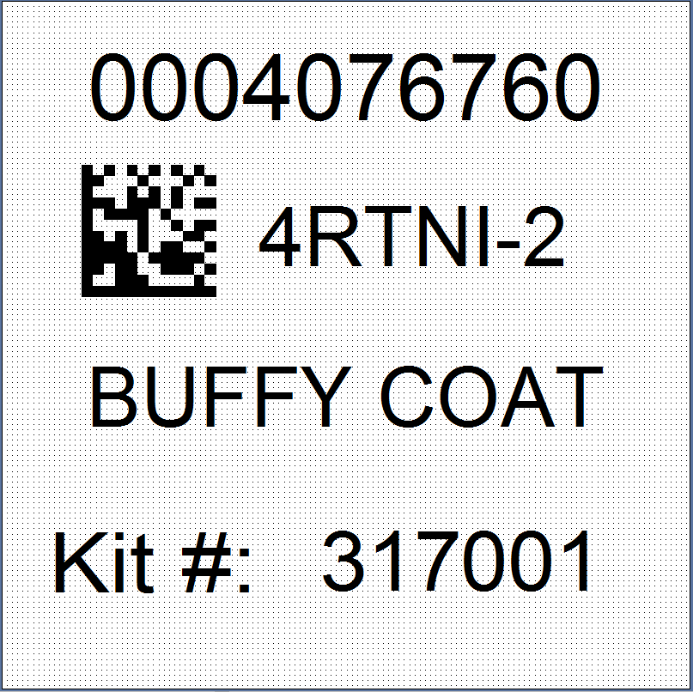
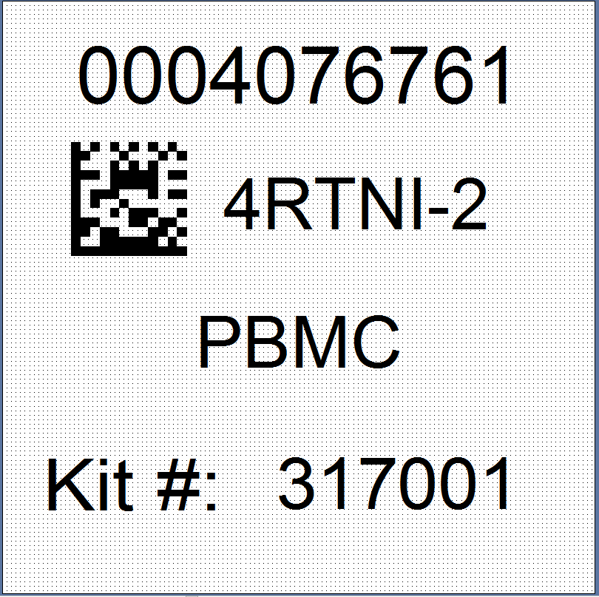
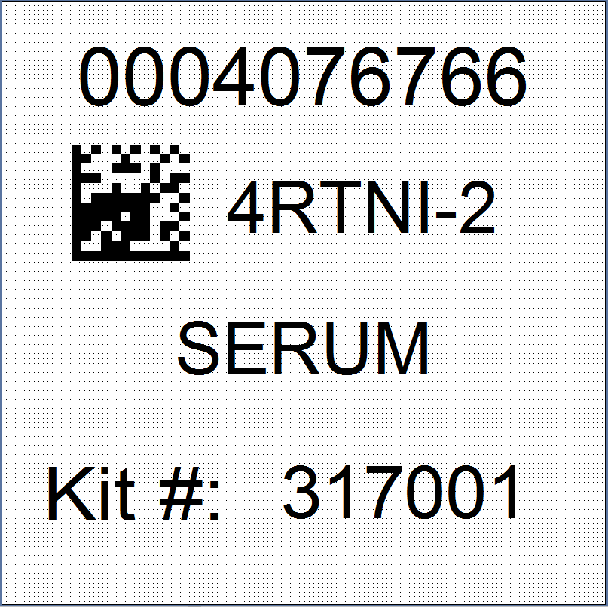
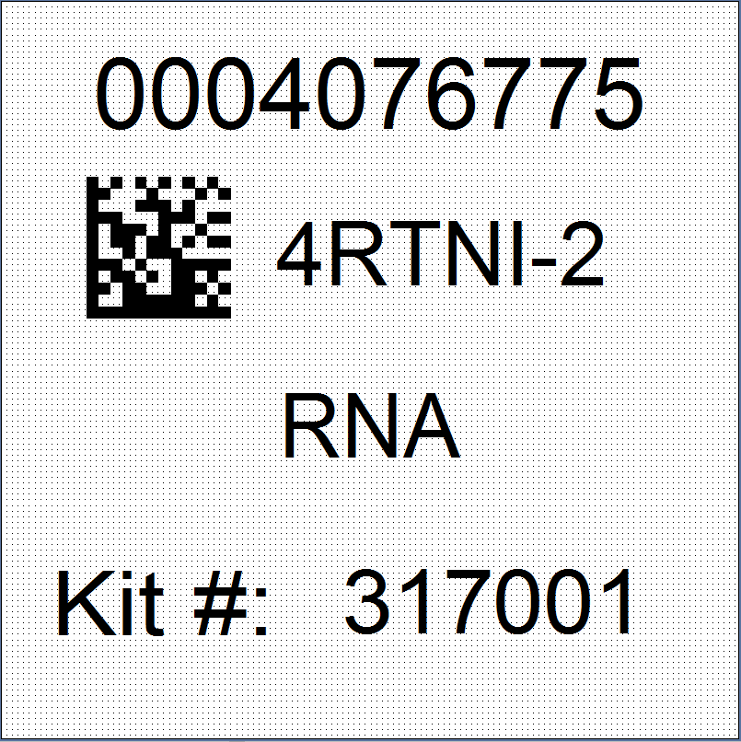
Three Label Types
Kit Number
Site and RAVE ID
Collection and Aliquot Tube

Slide 15
Kit Number Labels
Used to track patient samples and provide quality assurance
Will be placed on the following locations:
  Biological Sample and Shipment Notification Form
  CSF Sample and Shipment Notification Form (IF COLLECTED)
  Outside cryobox that houses aliquot tubes during storage and shipment
  Outside of the biohazard bag that houses PAXgene™ tubes and aliquot tubes during shipping process
  Outside of the biohazard bag that houses the PBMC
CSF samples will have a different kit number label than the blood collection specimens
  Provided by NCRAD in the kits

Slide 16
Site and RAVE ID Labels
Subjects will be identified by their site ID and RAVE #
The RAVE # may only be available shortly before the visit
Sites will be responsible for handwriting this onto the provided labels
  Write information on label prior to adhering to tube
  Must use a fine point marker
  Will be placed on all collection tubes

Slide 17
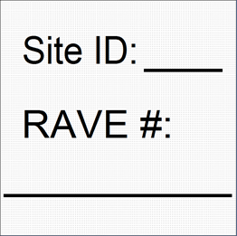
Collection Tubes - BLOOD
Label 1: collection tube label
Label 2
PAXgene™ Tube
Sodium Heparin Tube
All collection tubes will have two labels
  The collection tube labels
  The handwritten Site and RAVE label
EDTA Tube
Serum Determination Tube

Slide 18
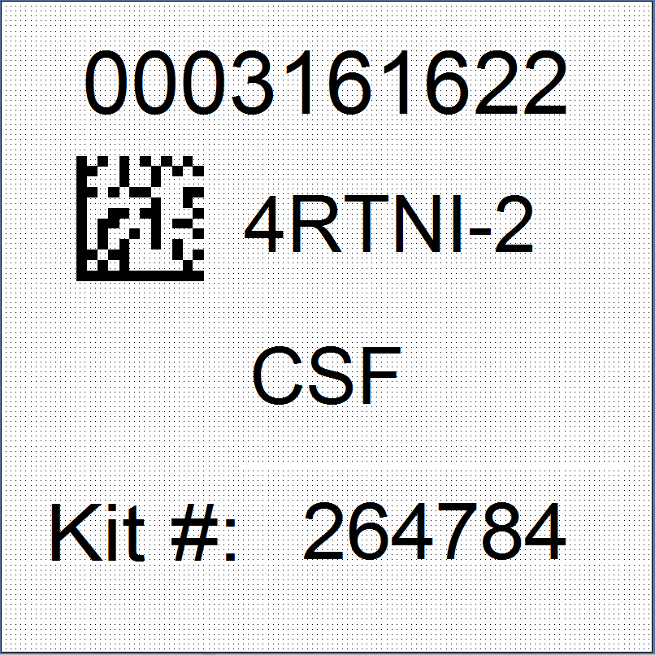
Aliquot Tube Labels –
Plasma, Serum, Buffy Coat, CSF
Only one label to be placed on ALL aliquot tubes
Plasma
  From EDTA tube
Buffy Coat
  From EDTA tube
Serum
  From serum determination tube
CSF
  (Cycles 1, 3, and 4. Only Cycle 2 if termination visit)
EDTA Tube
Serum Tube
EDTA Tube
Lumbar Puncture

Slide 19
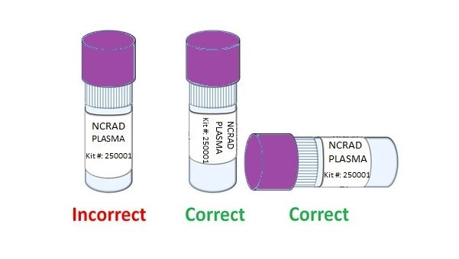
Labeling Biologic Samples
Please...
Label all collection and aliquot tubes before cooling, collecting, processing or freezing samples
Label only 1 subject’s tubes at a time to avoid mix-ups
Wrap the label around the tube horizontally. Label position is important for all tube types
Make sure the label is completely adhered by rolling between your fingers

Slide 20
Collection and Aliquot Tube Labels- CSF
Separate Kit Number for CSF collection
  Kit number will differ from kit number used for the blood samples for the same subject at the same visit
CSF label
  Collection tubes
  CSF aliquots
Remember: CSF collection in Cycle 1, 3, and 4. Only Cycle 2 if termination visit.

Slide 21
Sample Forms

Slide 22
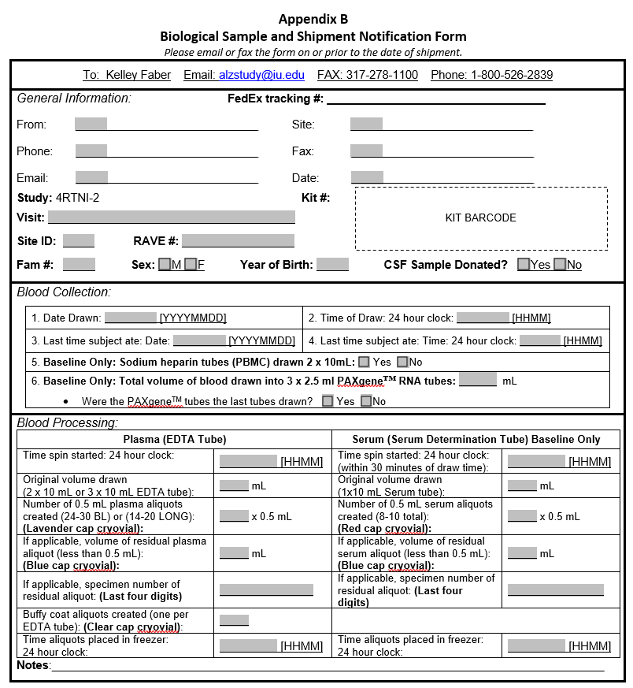
Biological Sample and Shipment Notification Form - Blood
Includes expanded blood processing section for both Plasma and Serum
All aspects of the form should be completed prior to shipping

Slide 23
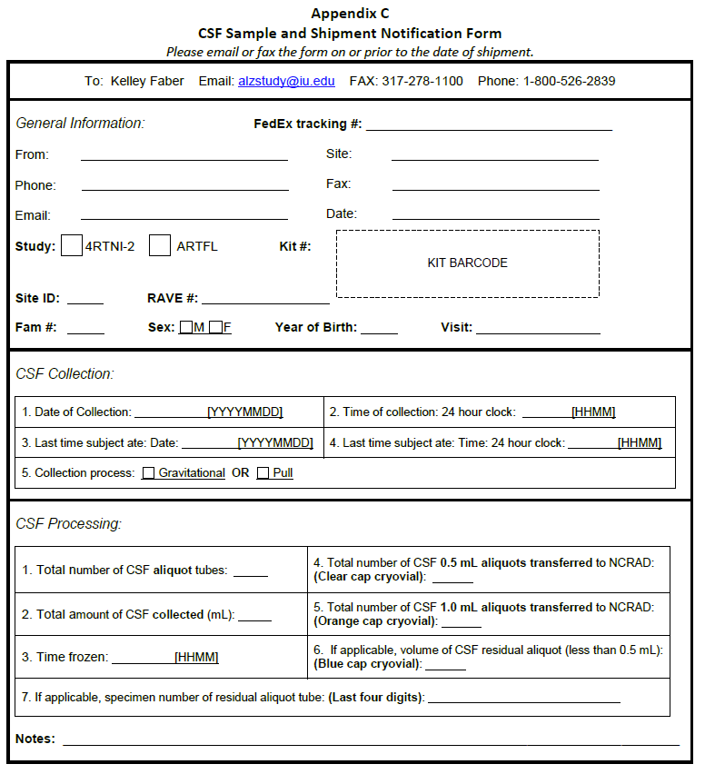
Biological Sample and Shipment Notification Form – CSF

Slide 24
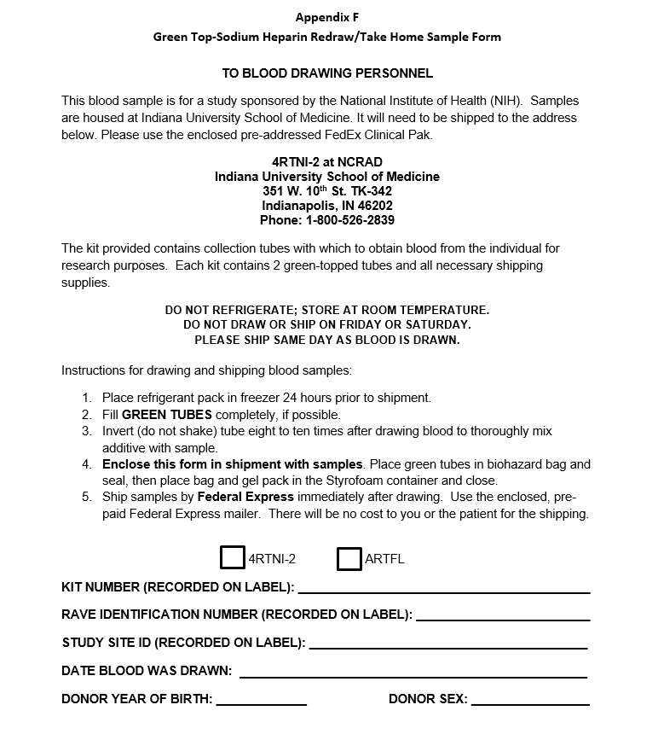
Redraw/Take Home Sample Form - PBMC

Slide 25
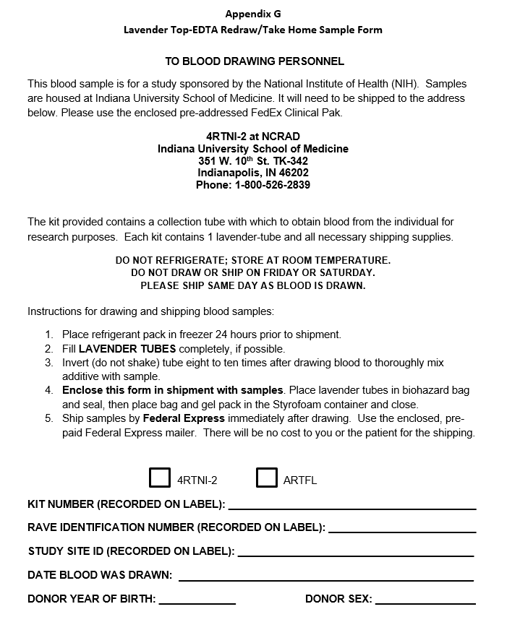
Redraw/Take Home Sample Form - EDTA

Slide 26

Biological Sample and Shipment Notification Forms
A copy of the sample form must be emailed or faxed to NCRAD prior to the date of sample arrival.
Please include sample forms in all shipments of frozen and ambient samples.
Email: alzstudy@iu.edu
Fax: 317-278-1100

Slide 27
Handling/Processing
Study Specimens

Slide 28



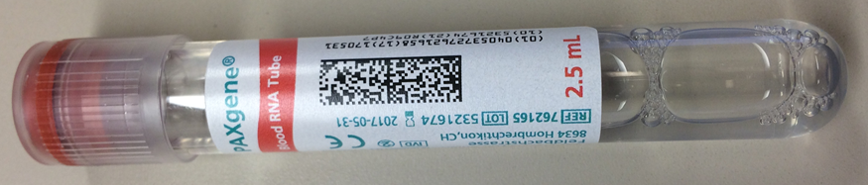
Blood Draw Order
Tube Type | Number of Tubes Drawn | Tube Image
EDTA (Lavender-Top) Tube (10 ml) | X3 (BL Visit) OR X2 (Long. Visit)
Sodium Heparin (Green-Top) Tube (10 ml) Cycle 1 Only | x2
Serum Determination (Red-Top) Tube (10 ml) Cycle 1 Only | x1
PAXgene™ Tube (2.5 ml) Cycle 1 Only | x3

Slide 29





Cryovial Cap Colors
Cap Color | Sample Type | Cap Image
Lavender | Plasma
Clear | Buffy Coat
Red | Serum
Clear | CSF Aliquot (0.5 ml)
Orange | CSF Aliquot (1.0 ml) and CSF Aliquot to local lab
Blue | Residual Aliquot (Plasma, Serum, or CSF)

Slide 30

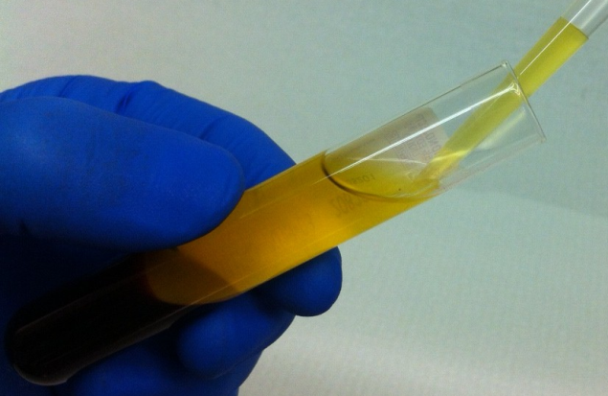
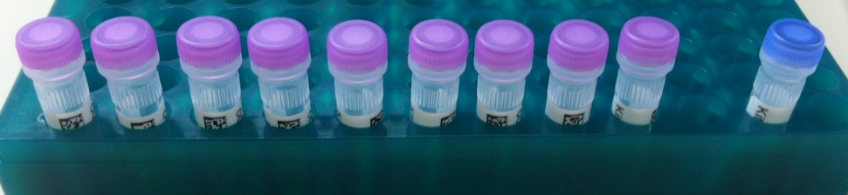
Plasma Collection
Residual Aliquot with Blue Cap
Create up to 30 aliquots at baseline visit, up to 20 aliquots at longitudinal visits
Please see the NCRAD Website for video for tutorials:
https://ncrad.org/resource_4rtni.html

Slide 31
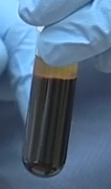


Buffy Coat Collection
Buffy Coat layer (mixed with RBCs)
Buffy Coat Aliquot
NCRAD Tutorials: http://kits.iu.edu/artfl-lefftds/videos

Slide 32
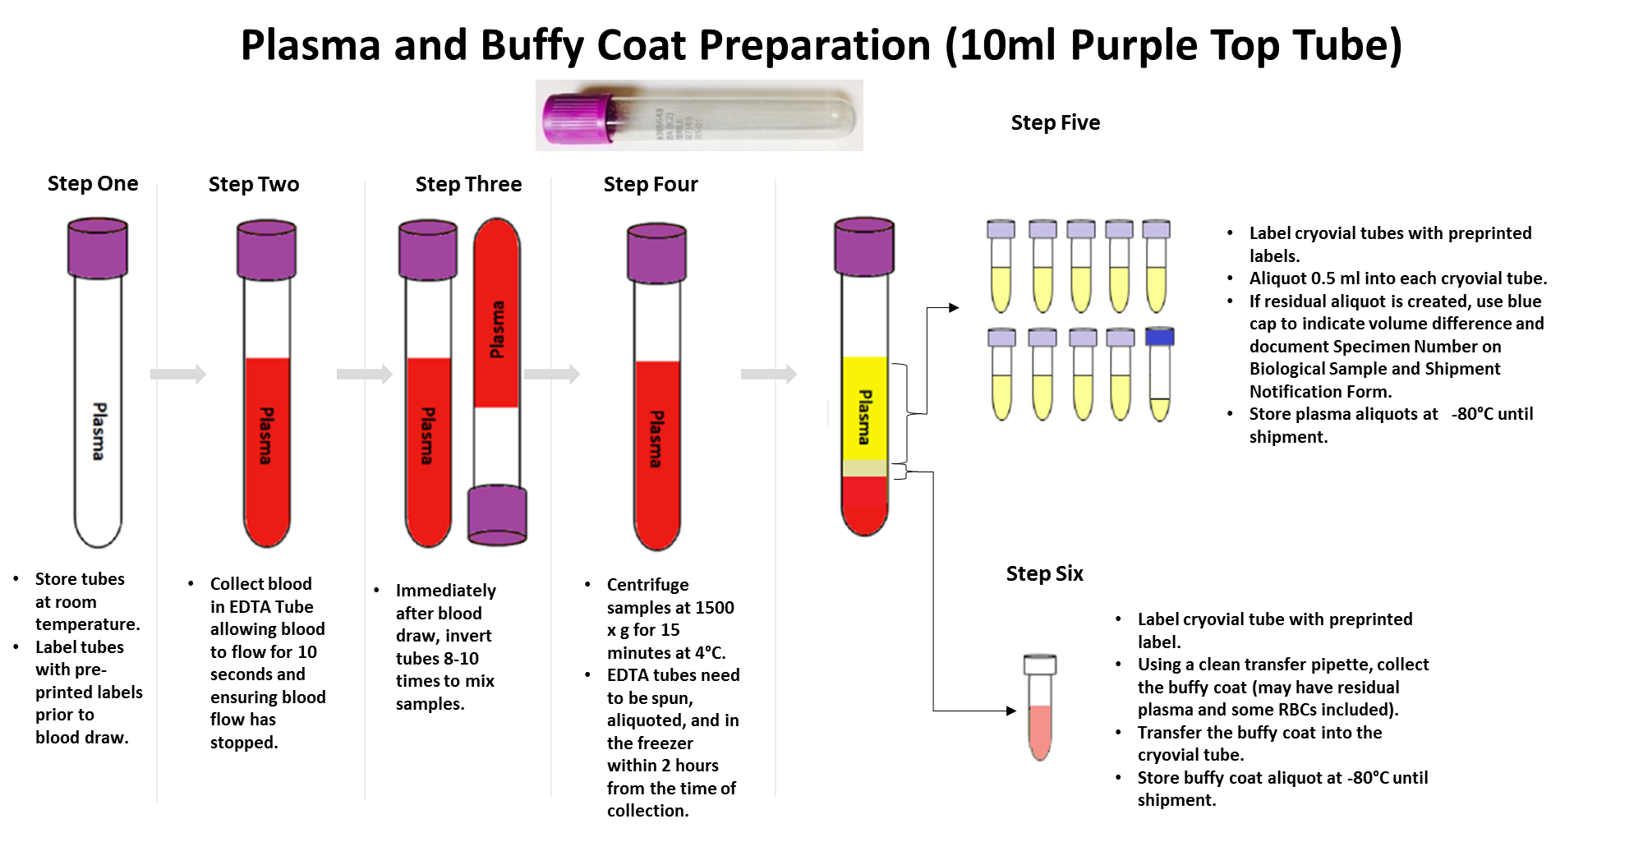
Three EDTA (Lavender-Top) Blood Collection Tubes will yield approximately:
  24 to 30 Plasma aliquots with 0.5 ml per aliquot
  3 Buffy Coat aliquots with 1.0 ml per aliquot

Slide 33
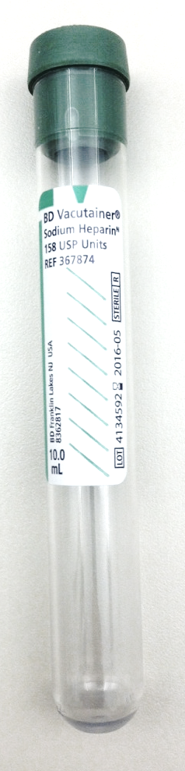
PBMC Collection
2 x Sodium heparin (green top) BD Vacutainer® (10 ml)
  Not processed at site
  *NOTE*: Must be shipped AMBIENT to NCRAD the day sample is drawn
  Only draw and ship Monday through Thursday
  No Friday draws
At Baseline/Cycle 1 Visit Only

Slide 34
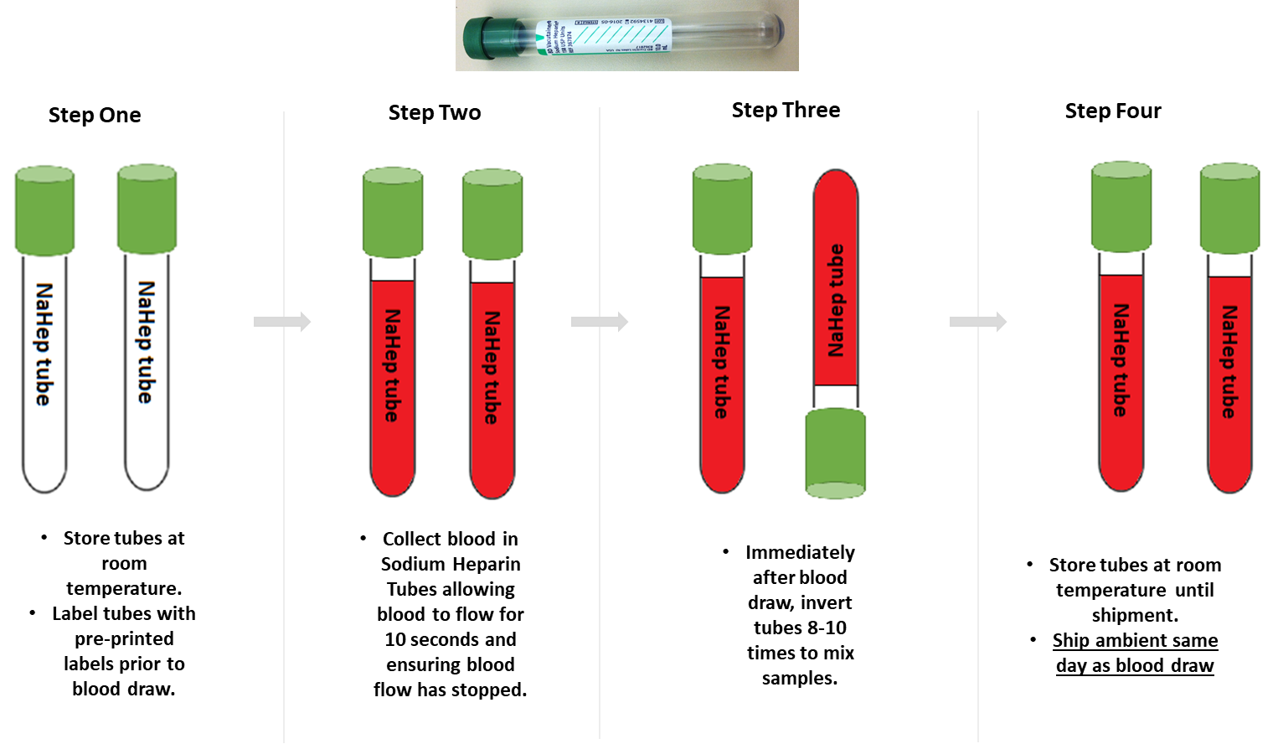
PBMC Preparation
(10ml Sodium Heparin Tube x 2)
At Baseline/Cycle 1 Visit Only

Slide 35
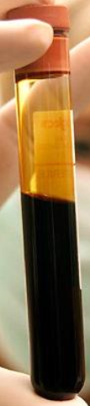
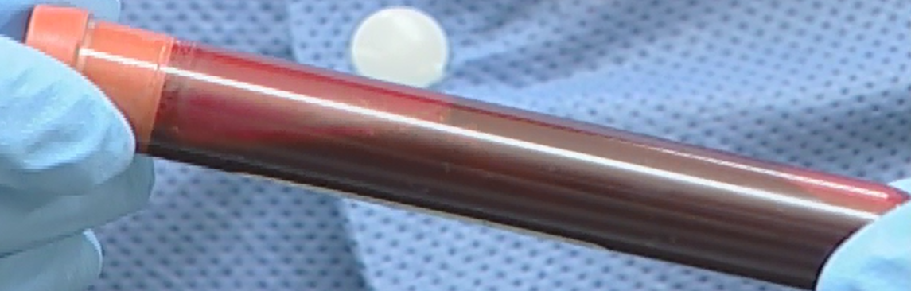

Serum Determination Tube
Serum Determination Tube
(Immediately after blood draw – pictured below)
** Please note: After standing at room temperature for 30 minutes, blood will be clotted and immobile**
Serum Determination Tube (unfilled)
Serum Determination Tube (after centrifuged)
At Baseline/Cycle 1 Visit Only

Slide 36
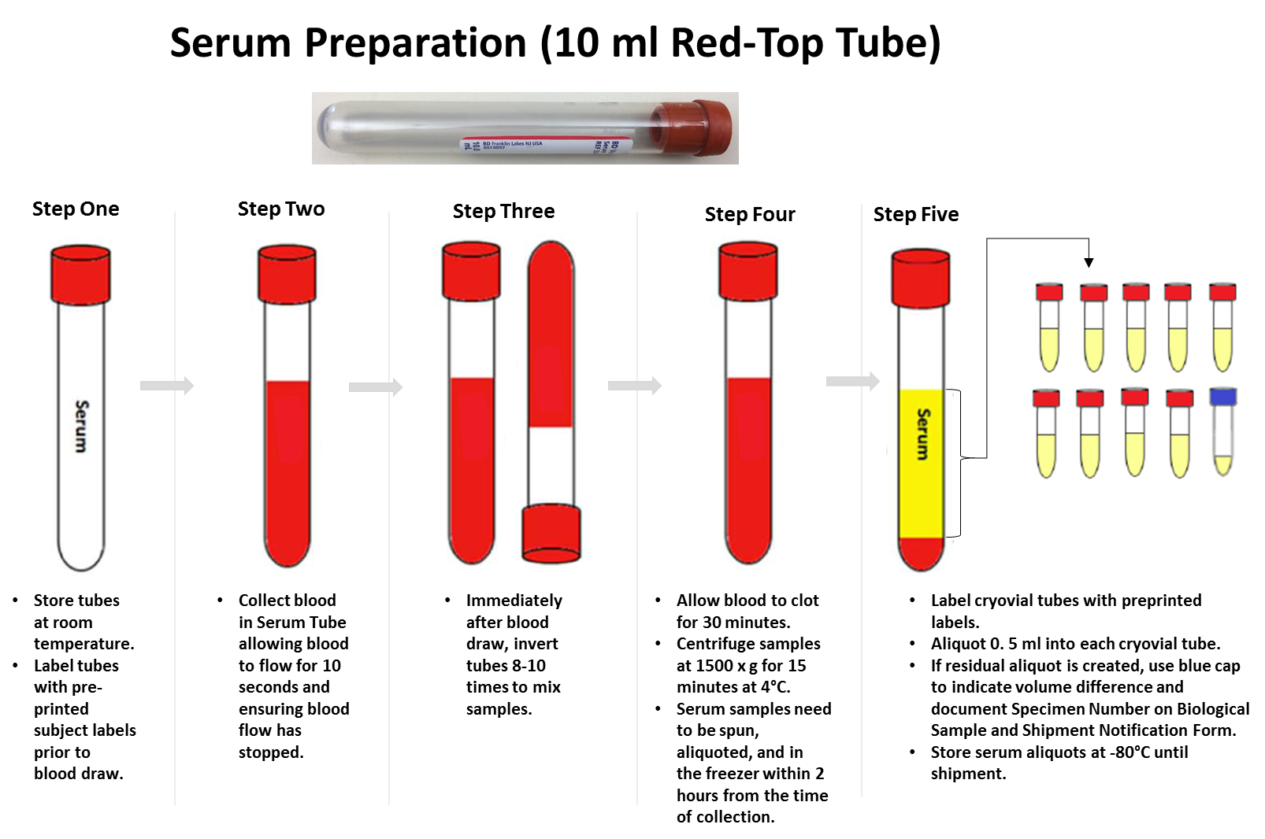
At Baseline/Cycle 1 Visit Only

Slide 37
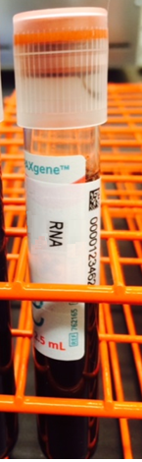
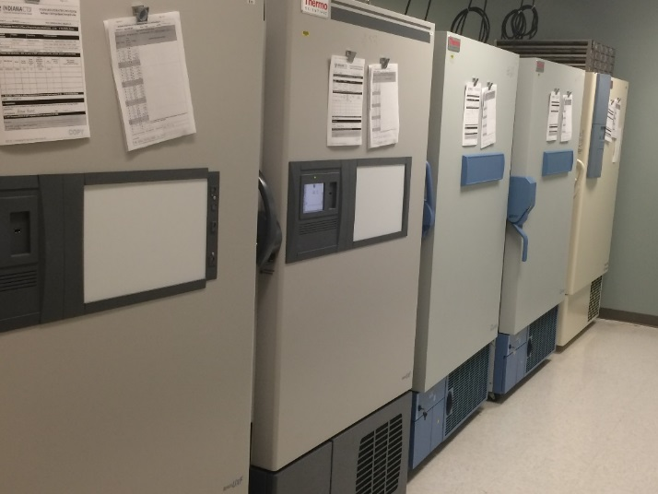

PAXgene™ Tube (RNA Collection)
http://www.preanalytix.com/videos/rna-tube-collection-video/
Documented within MOP for site staff review
Released by PreAnalytiX
At Baseline/Cycle 1 Visit Only

Slide 38
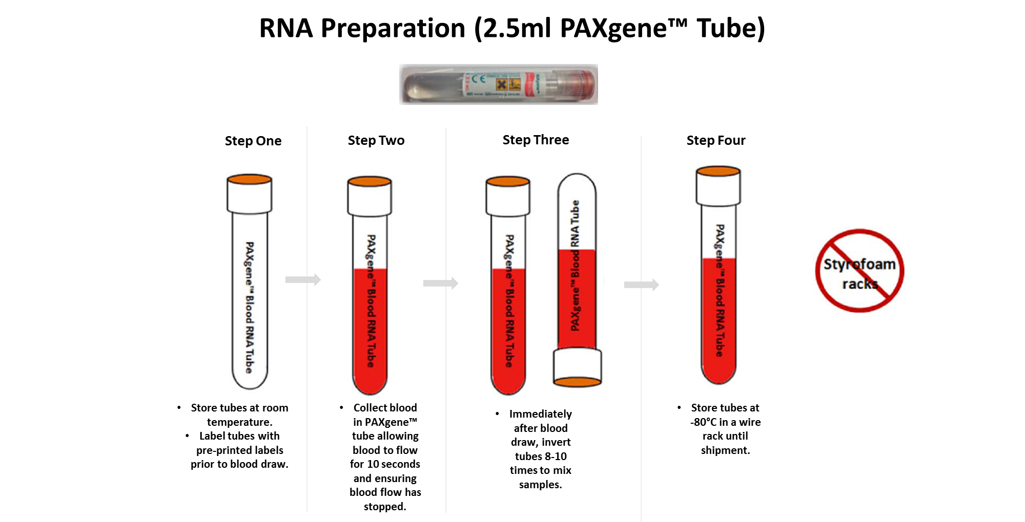
At Baseline/Cycle 1 Visit Only

Slide 39
CSF Collection and Processing
Collected at Baseline (Cycle 1), Cycle 3, and Cycle 4 visits.
Collected at Cycle 2 only if termination visit.

Slide 40
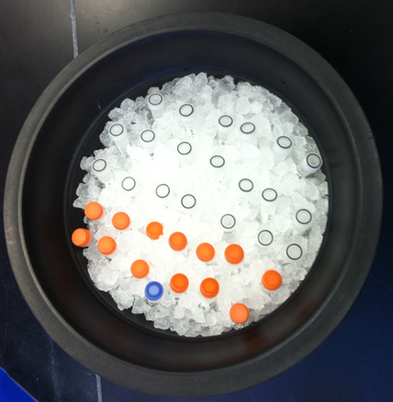
Pre-Ice CSF Cryovials
0.5 ml Aliquots (CLEAR CAP)
1.0 ml Aliquots (ORANGE CAP)
Residual Aliquot (BLUE CAP)
Helpful Tips:
Keep as organized as possible
Prelabel prior to adding cryovials in
wet ice
Pre-ice all cryovials included in kit

Slide 41
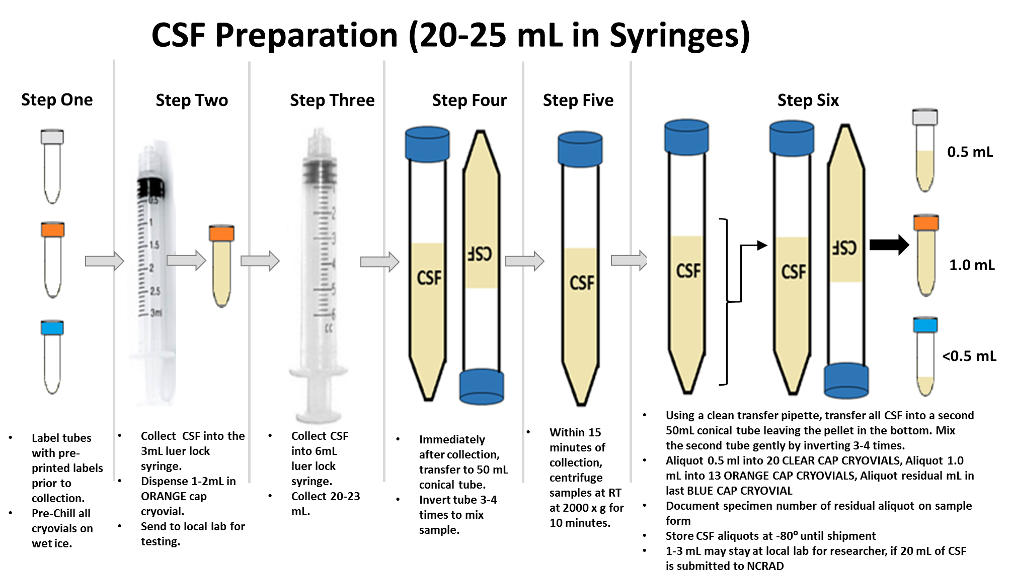


Slide 42
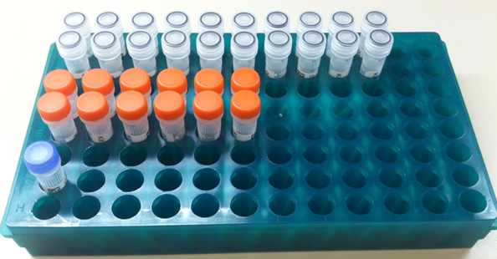
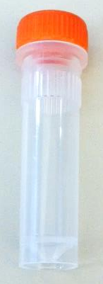
CSF Aliquots
0.5 ml Aliquots (CLEAR CAP)
1.0 ml Aliquots (ORANGE CAP)
Up to 33 aliquots!
Residual Aliquot (BLUE CAP)
CSF aliquot tubes
CSF aliquot tube for local lab
Label not provided for local lab sample
NCRAD Tutorials: https://ncrad.org/resource_4rtni.html

Slide 43
Sample Shipments

Slide 44
Sample Shipment Summary
Sample Type | 4RTNI-2 Study Visit | Processing/ Aliquoting | Tubes to NCRAD | Ship
Whole blood (Lavender-Top EDTA) for isolation of plasma & buffy coat (for DNA extraction) | All Cycles | 0.5 ml plasma aliquots per 2 ml cryovials | 24-31 (Cycle 1) 16-21 (Cycle 2-4) | Frozen
 | All Cycles | 1 ml buffy coat aliquot per 2 ml cryovial | 2-3 | Frozen
Whole blood (Green-Top Sodium Heparin) for isolation of PBMCs | Cycle 1 Only | N/A | 2 | Ambient
Whole blood (Red-Top Serum) for isolation of serum | Cycle 1 Only | 0.5 ml serum aliquots per 2 ml cryovials | 8-11 | Frozen
Whole blood (PAXgene™) for RNA extraction | Cycle 1 Only | N/A | 3 | Frozen
CSF | Cycle 1, 3, and 4 (Visit 2 if Termination Visit) | 0.5 ml and 1 ml CSF aliquots per 2 ml cryovials | Up to 33 | Frozen

Slide 45
Ambient Sample Shipment
Sodium Heparin/PBMC
Only Monday-Thursday collection and same day shipping. Plan ahead to schedule FedEx.
Samples must be received at NCRAD one day after collection.
Do NOT draw or ship ambient samples on Friday
Include copy of Biological Sample Shipment and Notification Form

Slide 46
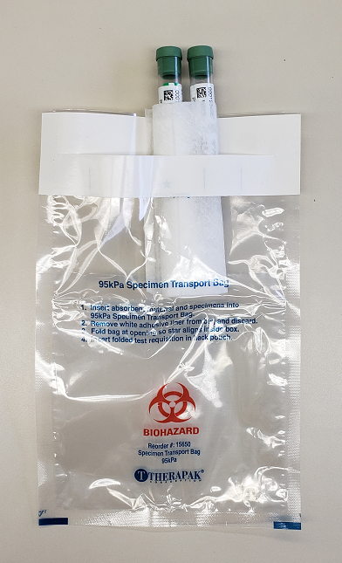
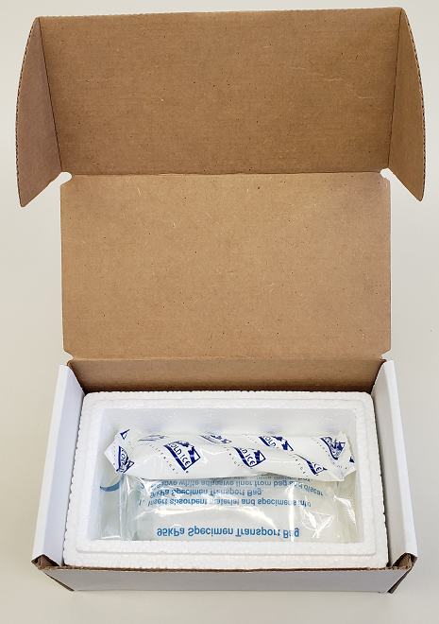
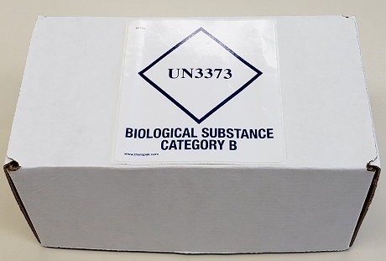
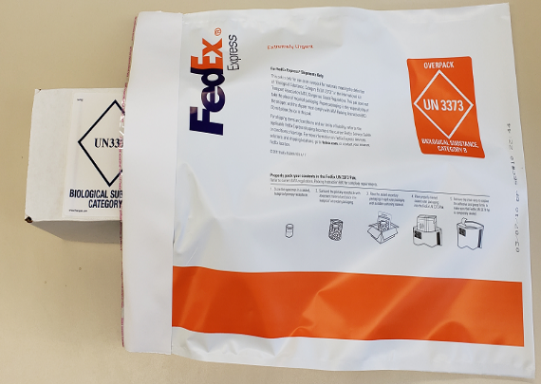
Ambient Shipment Packaging
Place the ambient PBMC tubes in the absorbent slots and biohazard bag.
Place the kit number label on the outside of the biohazard bag.
Place the bag inside the small shipping box, and then set the refrigerant pack on top of it.
Place small shipping box within a provided FedEx Clinical Pak, seal, and place FedEx label on outside of package.
*Gel packs must be put in a freezer at minimum the night before shipping.

Slide 47
Frozen Sample Shipment
All other samples
  Plasma, Buffy Coat, Serum, PAXgene™, and CSF
  Ship Monday-Wednesday Only
Hold packaged samples in a -80°C freezer until pickup.
Include copy of Biological Sample Shipment and Notification Form
Batch samples together
  4 participant samples (Plasma, Buffy, Serum, RNA, CSF)
  Batch shipping should be performed quarterly or as a full shipment of specimens accumulates, whichever is sooner.

Slide 48
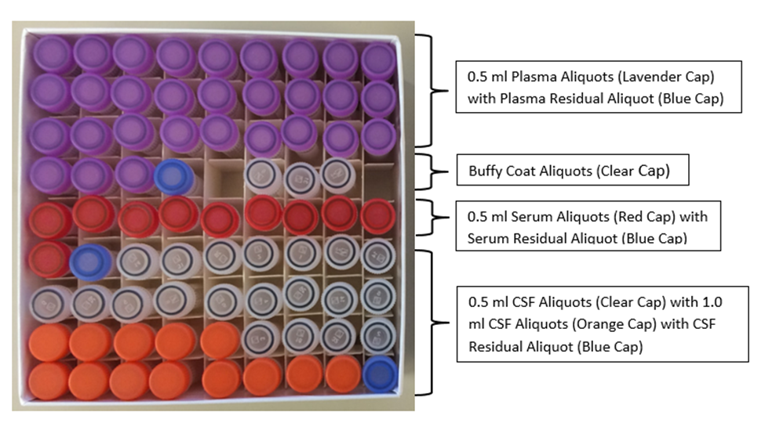
Frozen Sample Shipment (Baseline + CSF)
Place all frozen, labeled aliquots from one patient in the 81-slot cyrobox.
To note: This cryovial box will have two kit number stickers adheared to the outside

Slide 49
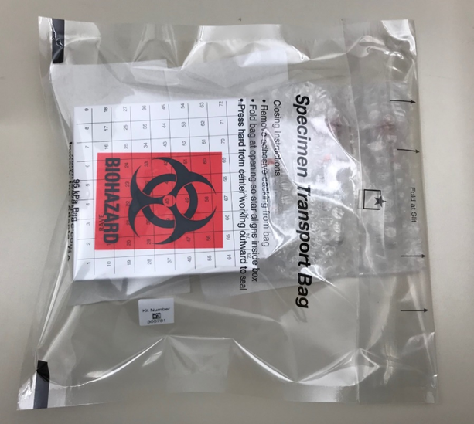
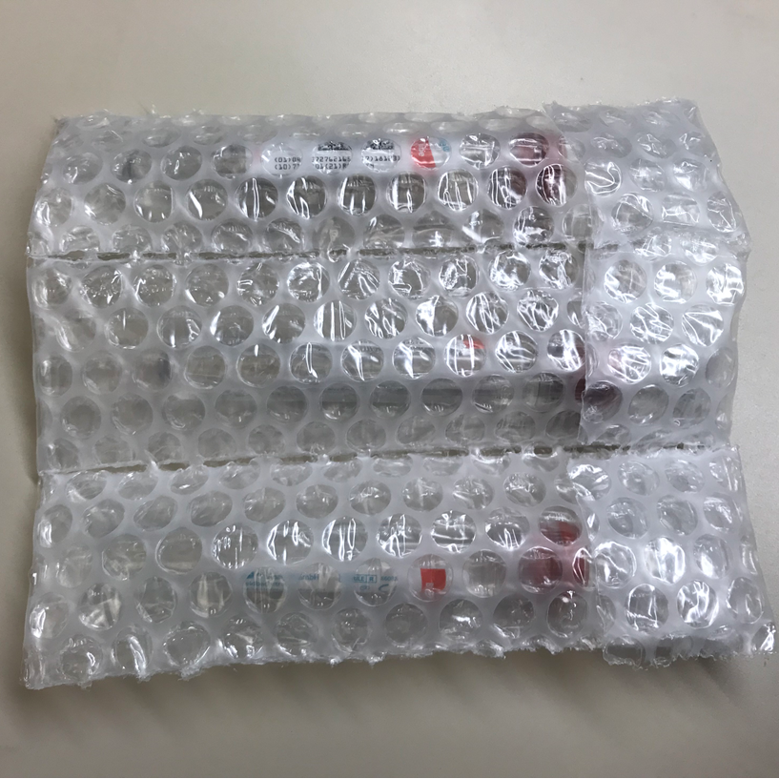
Frozen Sample Shipment
Use the large biohazard bag to accommodate the 81-Slot Cryobox and PAXgeneTM tubes.
Insert PAXgeneTM tubes into the bubble slots and place within the large biohazard bag.
Place kit number on outside of biohazard bag.

Slide 50
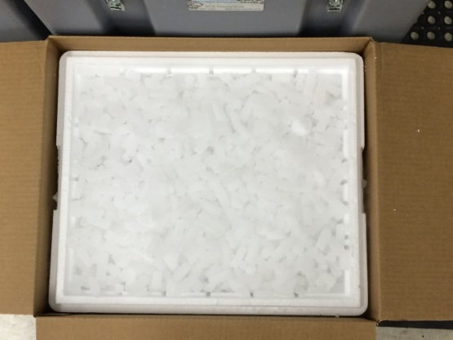
Frozen Sample Shipment
Place 2-3 inches of dry ice in the bottom of the Styrofoam shipping container, then insert the cryoboxes and tubes laying upright.
Fully cover the cryoboxes with about 2 inches of dry ice in the provided shipper.
Each Styrofoam shipper must contain about 45 lbs (20 kg) of dry ice.

Slide 51
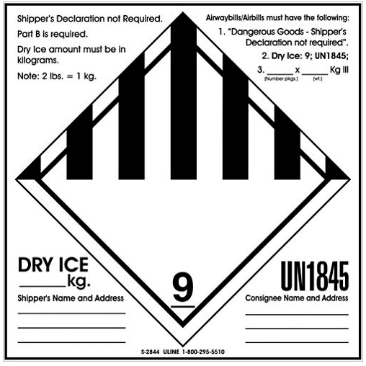
Frozen Sample Shipments
Class 9 Dry Ice label should not be covered with other stickers and must be completed or the shipping carrier will reject/return your package!
Number of packages in shipment and dry ice in kg
Net weight of dry ice in kg
Your name & address
Repository name & address

Slide 52
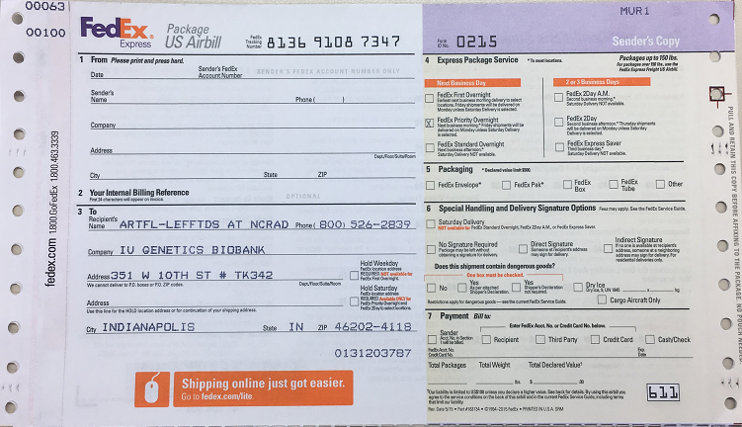
Fedex Airbill
Airbill must be completed or the shipping carrier will reject/return your package!
Your name, address & phone
Dangerous goods info
(for dry ice shipments only)
4RTNI-2
Net weight of dry ice in kg
x
x
20

Slide 53
Nonconformance Issues
Recommendation: Place aliquots in Argos boxes/tube rack in freezer upright until shipment
Sample aliquots and collection tubes frozen at an angle/inverted
Fields left blank on Sample and Shipment Notification Forms
    Last time subject ate often left blank/unknown
Incorrect data reported on Sample and Shipment Notification Forms
Multiple low volume plasma/CSF aliquots
Recommendation: Complete Sample Notification forms during the participant study visit as samples are processed.
Recommendation: Lay out cryovials in a row and aliquot in order until plasma/CSF is depleted

Slide 54
Nonconformance Cont.
All frozen samples for a participant not sent within one shipment box (RNA tubes, plasma, buffy coat, and serum aliquots should be kept together)
Aliquots arriving to NCRAD without labels
Sample forms not faxed or scanned to NCRAD the day before shipment
Recommendation: Ship Samples to NCRAD utilizing the Notification Form, by RAVE ID. Do not throw away labels until samples are packed and shipped.
Recommendation: No samples should be held ambient for any period of time at the site. Ensure all samples are frozen or shipped by end of the day.
PBMC sample not shipped the day of blood draw

Slide 55
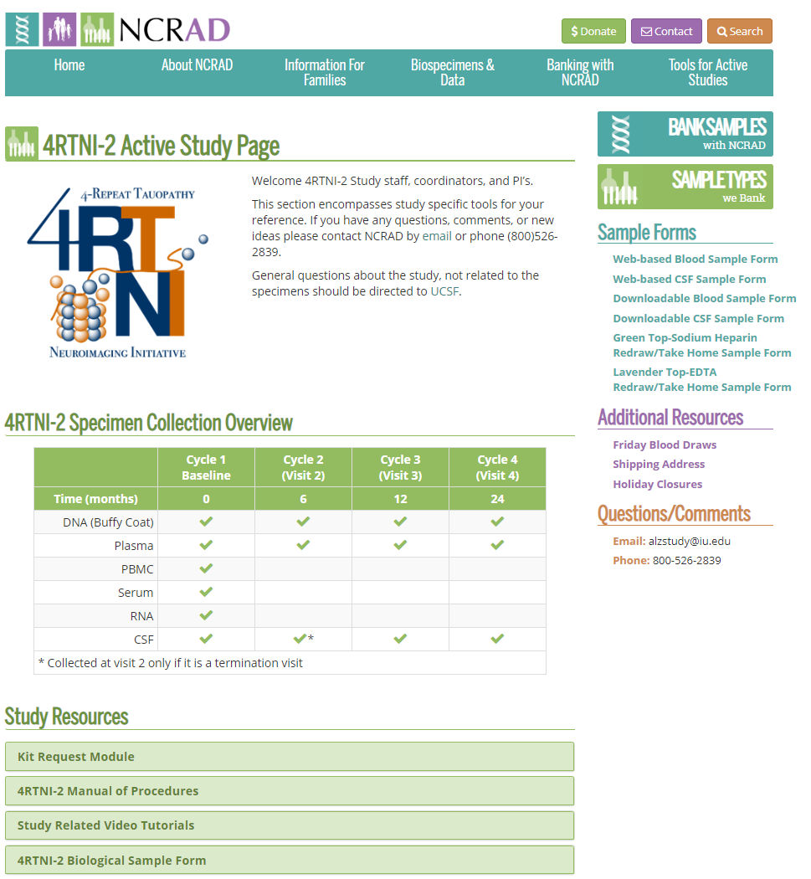
NCRAD Website
4RTNI-2 Active Study Page

Slide 56

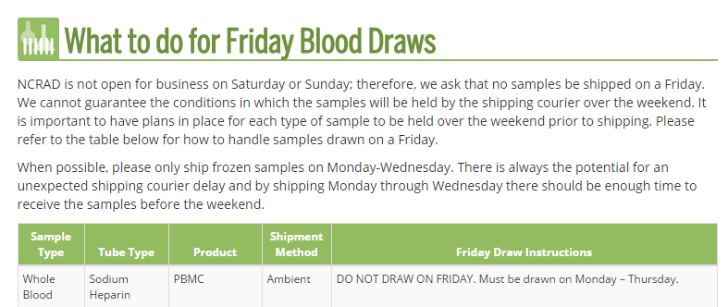
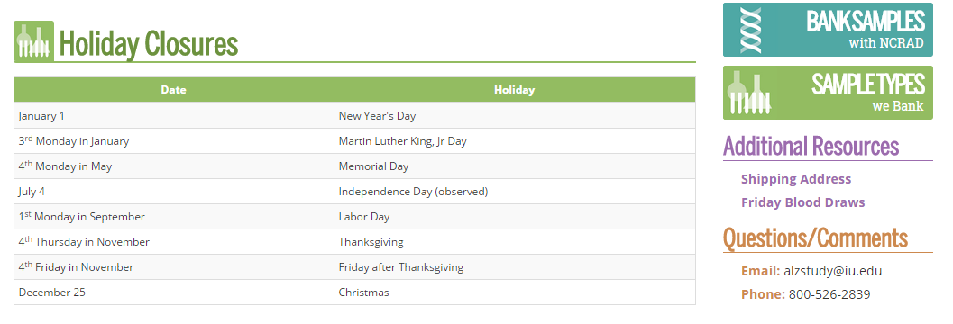
NCRAD Website
Helpful Pages
NCRAD Holiday Closures
What to do for Friday blood draws?
4RTNI-2 Active Study Page

Slide 57
Contact Information
Questions?
General Information
  Phone: 1-800-526-2839
  E-mail: alzstudy@iu.edu
  Website: www.ncrad.org
Justin Delay
Phone: 317-278-1654
E-mail: jndelay@iu.edu

